Slide 1
Problem solving
Blind search

Slide 2
What is a problem
You are in some state of the world,
Its not the state you want to be in.
E.g.
- in a lecture vs sleeping
- I have an assignment to do and its not done
- don’t have x, want x
- job/money/secure comfortable future
- a world full of people that treat each other kindly
- I have an N-puzzle with the pieces in the wrong places
…

Slide 3
How do you solve a problem?
Obvious: Do what needs doing
Trial and error: do anything!
Intuitive: do what feels right
Ask for help (info or action)
Learn
Wait
Manage expectations
Logical: do the action(s) that change the state of the world as desired

Slide 4
The classical AI approach
Assume a finite set of states
Assume a set of actions is given
Describing the new state of the world from each action
What if none of the new states match the goal state?
What is a solution to a problem?
- a sequence of actions that takes you from the start state to the goal state

Slide 5
How do we find that sequence?
Enumerate all sequences of actions and see which ones arrive at goal?
How many possible sequences of actions are there?
How many solutions are there?
Are all solutions equally good solutions?
Are all methods that find a solution equally good methods?
What criteria?
If we are going to try sequences in a particular order, rather than generating all of them, then what order?
And how does this choice affect those criteria?

Slide 6
Example: Romania
On holiday in Romania; currently in Arad.
Flight leaves tomorrow from Bucharest
Formulate goal:
  be in Bucharest
Formulate problem:
  states: various cities
  actions: drive between cities
Find solution:
  sequence of cities (drives), e.g., Arad, Sibiu, Fagaras, Bucharest

Slide 7
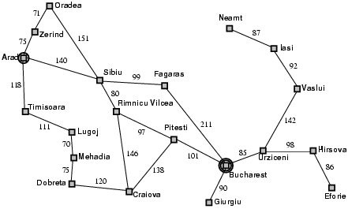
Example: Romania

Slide 8
Single-state problem formulation
A problem is defined by four items:
initial state e.g., "at Arad"
actions or successor function S(x) = set of action–state pairs
  e.g., S(Arad) = {<Arad → Zerind, Zerind>, … }
goal test, can be
  explicit, e.g., x = "at Bucharest"
  implicit, e.g., Checkmate(x)
cost of actions (additive)
  e.g., sum of distances, number of actions executed, etc.
  c(x,a,y) is the step cost, assumed to be ≥ 0
A solution is a sequence of actions leading from the initial state to a goal state

Slide 9
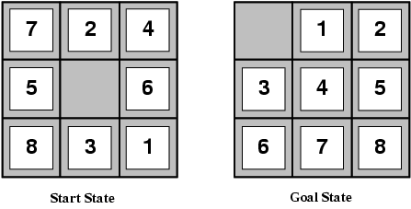
Example: The 8-puzzle
states?
actions?
goal test?
path cost?

Slide 10
Example: The 8-puzzle
states? configuration of tiles
actions? move blank left, right, up, down
goal test? = goal state (given)
path cost? 1 per move
[Note: optimal solution of n-Puzzle family is NP-hard]

Slide 11
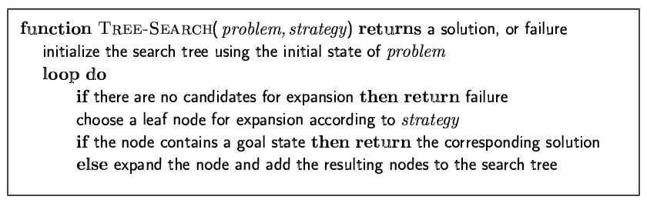
Tree search algorithms
Basic idea:
  offline, simulated exploration of state space by generating successors of already-explored states (a.k.a.~expanding states)

Slide 12
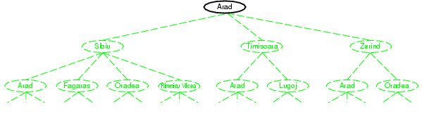
Tree search example

Slide 13
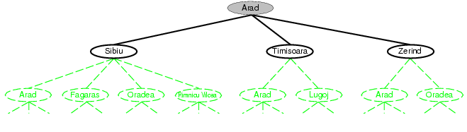
Tree search example

Slide 14
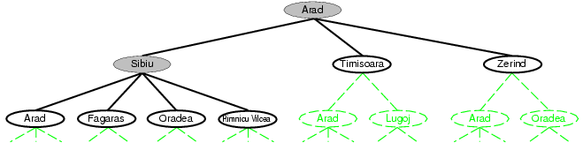
Tree search example

Slide 15
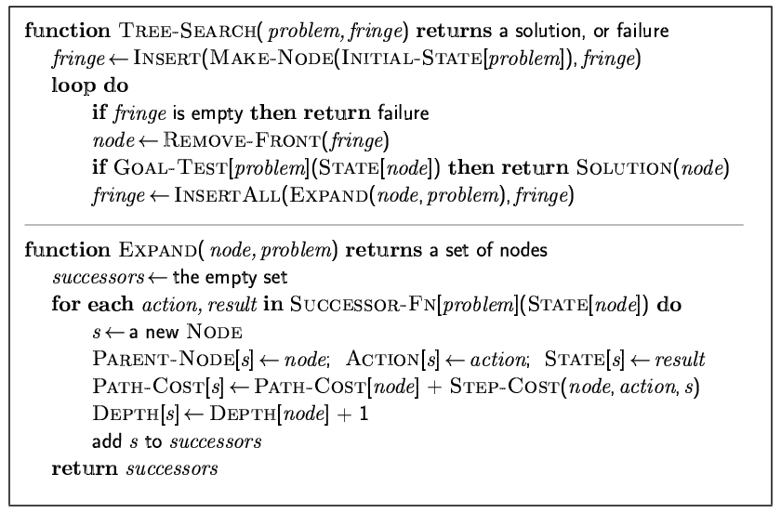
Implementation: general tree search

Slide 16
Implementation: states vs. nodes
A state is a (representation of) a physical configuration
A node is a data structure constituting part of a search tree includes state, parent node, action, path cost g(x), depth
States and nodes are not the same thing!

Slide 17
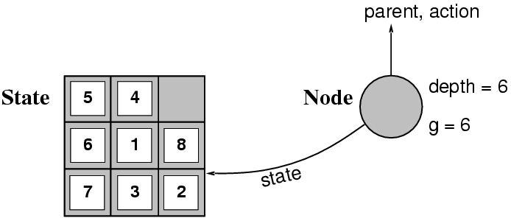
Implementation: states vs. nodes
The Expand function creates new nodes, filling in the various fields and using the SuccessorFn of the problem to create the corresponding states.

Slide 18
Search strategies
A search strategy is defined by picking the order of node expansion
Strategies are evaluated along the following dimensions:
  completeness: does it always find a solution if one exists?
  time complexity: number of nodes generated
  space complexity: maximum number of nodes in memory
  optimality: does it always find a least-cost solution?
Time and space complexity are measured in terms of
  b: maximum branching factor of the search tree
  d: depth of the least-cost solution
  m: maximum depth of the state space (may be ∞)

Slide 19
Uninformed search strategies
Uninformed search strategies
  use only the information available in the problem definition
Breadth-first search
Depth-first search
Depth-limited search
Iterative deepening search

Slide 20
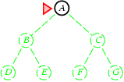
Breadth-first search
Expand shallowest unexpanded node
Implementation:
  fringe is a FIFO queue, i.e., new successors go at end

Slide 21
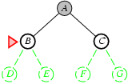
Breadth-first search
Expand shallowest unexpanded node
Implementation:
  fringe is a FIFO queue, i.e., new successors go at end

Slide 22
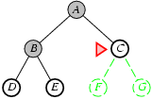
Breadth-first search
Expand shallowest unexpanded node
Implementation:
  fringe is a FIFO queue, i.e., new successors go at end

Slide 23
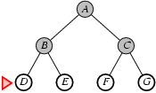
Breadth-first search
Expand shallowest unexpanded node
Implementation:
  fringe is a FIFO queue, i.e., new successors go at end

Slide 24
Properties of breadth-first search
Complete?
Time?
Space?
Optimal?

Slide 25
Properties of breadth-first search
Complete? Yes (if b is finite)
Time? 1+b+b²+b³+… +b^{d} + b(b^{d}-1) = O(b^{d+1})
Space? O(b^{d+1}) (keeps every node in memory)
Optimal? Yes (if cost = 1 per step)
Space is the bigger problem (more than time)

Slide 26
Q&A

Slide 27
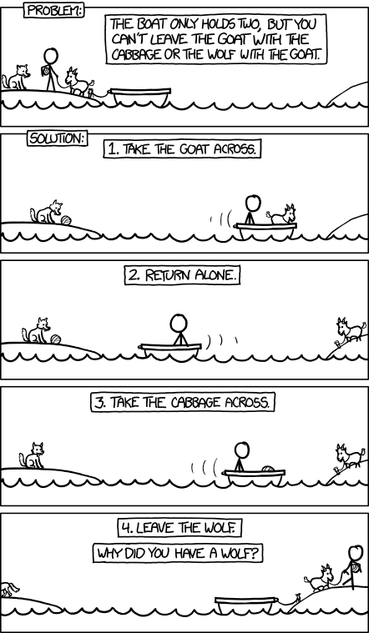

Slide 28


Start state: Fox, chicken, corn on one side of river.
Actions:
  Take the boat across the river with max one thing.
New state = the thing (and boat and farmer) is on the other side
  and:
    If the fox and the chicken are left unattended, chicken gets eaten.
    If the chicken and the corn are left unattended, corn gets eaten.
Goal state: everything on the other side.

Slide 29
Is there a reason to disregard this action?
Breadth first
How do you know left branch cannot be the right way?
How do you know its unnecessary to expand some branches?

Slide 31
A

Slide 32
B

Slide 33
A
B
A and B are the same state
but not the same solution

Slide 34
Notice the way your problem solving
≠ uninformed breadth-first tree search
- did you consider ALL available actions? (paths away from Bucharest, empty boat)
- domain knowledge (?): don’t expand states that have lost a character
  how do you know you cant get to the goal from there?
  how do you know there aren’t any actions that bring characters back?
- ‘look-ahead’:
  favour actions that go towards goal (direction of Bucharest, more characters on the other side of the river)
  don’t apply actions that will lead to loss of a character
- redundancy checking: why not expand states that have been visited before? (not doing this = “graph search”)
- change the goal/interpret goal differently: forget the wolf!
- notice also the need to keep track of multiple incomplete options
Some of these refinements can be captured by other search methods (heuristics, graph search, planning graphs, constraint checking – not all)
Consider: How often do you do problem-solving that involves SEARCH of this kind?

Slide 35
pause

Slide 36
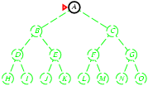
Depth-first search
Expand deepest unexpanded node
Implementation:
  fringe = LIFO queue, i.e., put successors at front

Slide 37
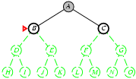
Depth-first search
Expand deepest unexpanded node
Implementation:
  fringe = LIFO queue, i.e., put successors at front

Slide 38
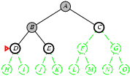
Depth-first search
Expand deepest unexpanded node
Implementation:
  fringe = LIFO queue, i.e., put successors at front

Slide 39
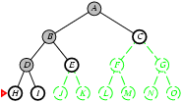
Depth-first search
Expand deepest unexpanded node
Implementation:
  fringe = LIFO queue, i.e., put successors at front

Slide 40
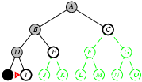
Depth-first search
Expand deepest unexpanded node
Implementation:
  fringe = LIFO queue, i.e., put successors at front

Slide 41
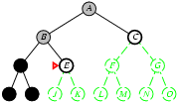
Depth-first search
Expand deepest unexpanded node
Implementation:
  fringe = LIFO queue, i.e., put successors at front

Slide 42
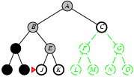
Depth-first search
Expand deepest unexpanded node
Implementation:
  fringe = LIFO queue, i.e., put successors at front

Slide 43
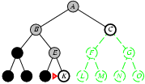
Depth-first search
Expand deepest unexpanded node
Implementation:
  fringe = LIFO queue, i.e., put successors at front

Slide 44
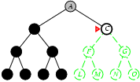
Depth-first search
Expand deepest unexpanded node
Implementation:
  fringe = LIFO queue, i.e., put successors at front

Slide 45
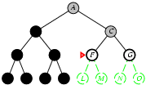
Depth-first search
Expand deepest unexpanded node
Implementation:
  fringe = LIFO queue, i.e., put successors at front

Slide 46
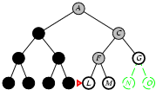
Depth-first search
Expand deepest unexpanded node
Implementation:
  fringe = LIFO queue, i.e., put successors at front

Slide 47
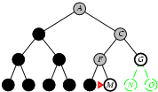
Depth-first search
Expand deepest unexpanded node
Implementation:
  fringe = LIFO queue, i.e., put successors at front

Slide 48
Depth first

Slide 50
Properties of depth-first search
Complete? No: fails in infinite-depth spaces, spaces with loops
  Modify to avoid repeated states along path
    complete in finite space
Time? O(b^{m}): terrible if m is much larger than d
  but if solutions are dense, may be much faster than breadth-first
Space? O(bm), i.e., linear space!
Optimal? No

Slide 51
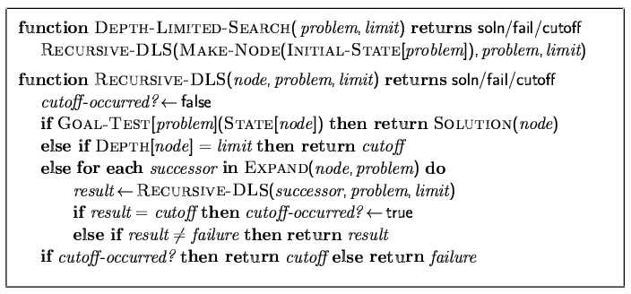
Depth-limited search
= depth-first search with depth limit n,
i.e., nodes at depth n have no successors

Slide 52
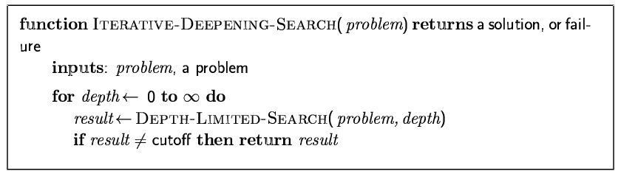
Iterative deepening search

Slide 53
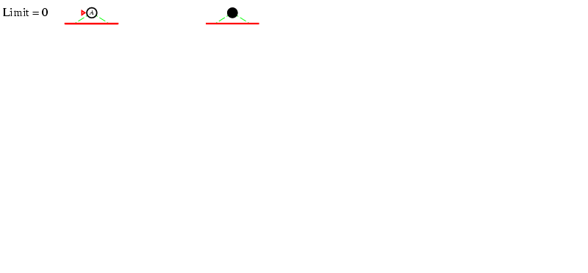
Iterative deepening search n =0

Slide 54
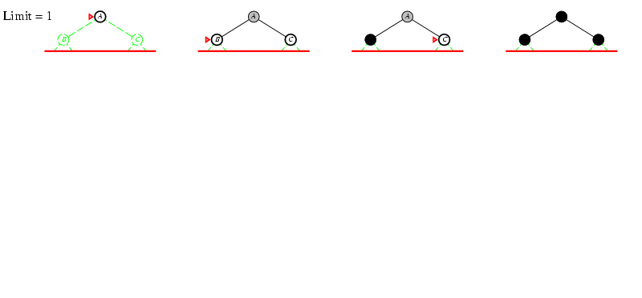
Iterative deepening search n =1

Slide 55
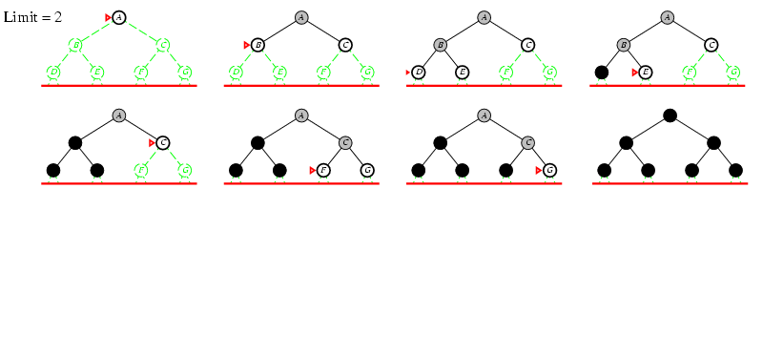
Iterative deepening search n =2

Slide 56
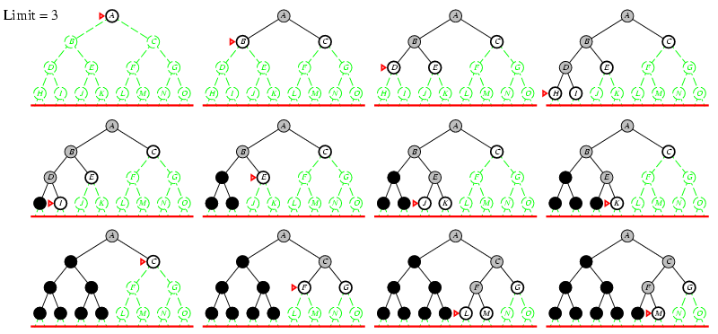
Iterative deepening search n =3

Slide 57
Iterative deepening search
Number of nodes generated in a depth-limited search to depth d with branching factor b:
N_{DLS} = b⁰ + b¹ + b² + … + b^{d-2} + b^{d-1} + b^{d}
Number of nodes generated in an iterative deepening search to depth d with branching factor b:
N_{IDS} = (d+1)b⁰ + d b¹ + (d-1)b² + …
+ 3b^{d-2} +2b^{d-1} + 1b^{d}

Slide 58
Iterative deepening search
For b = 10, d = 5,
N_{BFS} = 1+ 10 + 100 + 1,000 + 10,000 + 100,000 = 111,111
N_{IDS} = 6 + 50 + 400 + 3,000 + 20,000 + 100,000 = 123,456
IDS is not much slower
And only needs to store O(bd) nodes at any one time

Slide 59
Properties of IDS
Complete? Yes
Time? (d+1)b⁰ +db¹ + (d-1)b² +…+ b^{d} = O(b^{d})
Space? O(bd)
Optimal? Yes, if step cost = 1

Slide 60
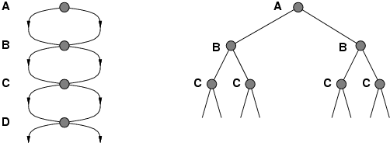
Repeated states
Failure to detect repeated states can turn a linear problem into an exponential one!

Slide 61
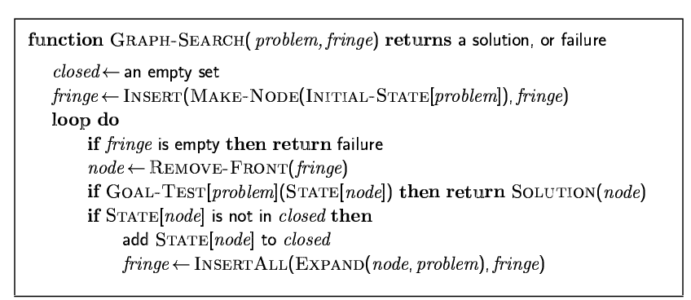
Graph search

Slide 62
Bidirectional Search
Do two searches
  One starts from the initial state
  One starts from the goal state
Motivation:
  b^{d/2} + b^{d/2} is much less than b^{d}
At each iteration of each search:
  Check if a node is in the fringe/open of the other before expansion
  If yes, a solution has been found

Slide 63
Bidirectional Search
Assumes Pred(x) is easy to compute
  Easy if Pred(x) = Succ(x)
If many goal states:
  Add a dummy node which has the true goal states as predecessors
Easy: 8-puzzle, Romania
Hard: Checkmate in chess

Slide 64
Summary
Problem formulation usually requires abstracting away real-world details to define a state space that can feasibly be explored
Variety of uninformed search strategies
Iterative deepening search uses only linear space and not much more time than other uninformed algorithms
Your problem solving is rarely ‘uninformed’

